Slide 1
cell biology lce ( 6 )
Cell junctions
And
Extracellular matrix
Multi-cellular organisms are association of cells into tissues. Tissues are formed from cell-cell connections and cell-matrix connections.

Slide 2
How are cells organized into tissues?
Cell junctions
Extracellular matrix proteins

Slide 3
There are five major types of cell junctions:
1- Tight junctions
2- Adherens junctions
3- Gap junctions
4- Desmosomes
5- Hemi-desmosomes

Slide 4
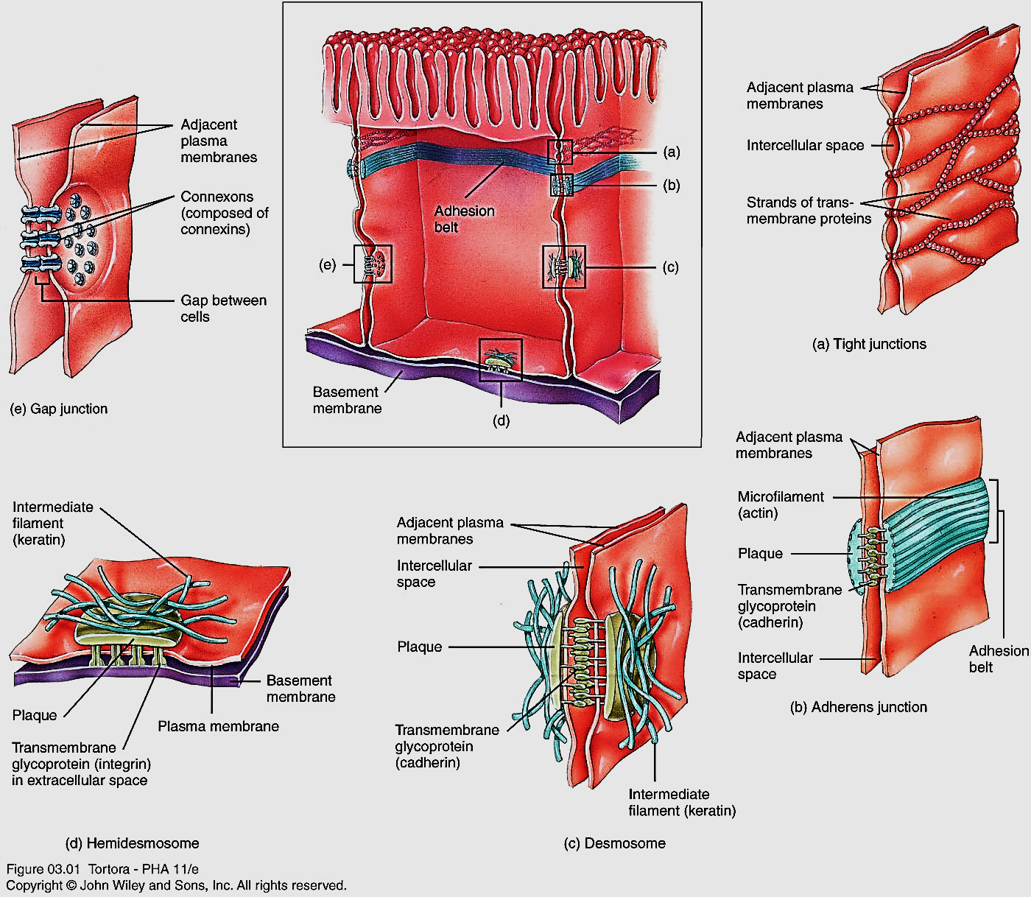
Tight junctions - form tight seals between cells; they prevent the passage of substances between cells.

Slide 5
Adherens junctions - strongly attach cells to each other; they help epithelial surfaces resist separation.

Slide 6
Gap junctions - formed by small tunnels that permit passage of electrical signals or chemicals (i.e., ions and small molecules) from one cell to a neighboring cell.

Slide 7
Desmosomes - strongly attach cells to each other; they prevent epidermal cells from separating under tension and cardiac muscle cells from pulling apart during contraction.

Slide 8
Hemidesmosomes - strongly clip cells to an underlying basement membrane.

Slide 9
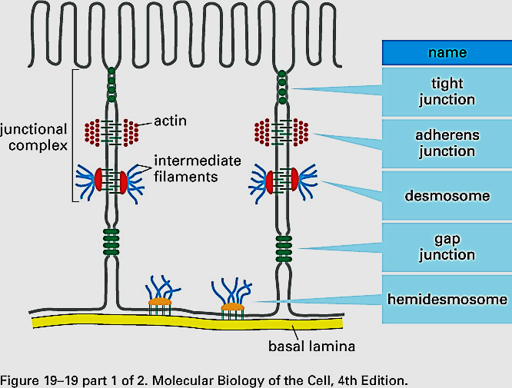

Slide 10
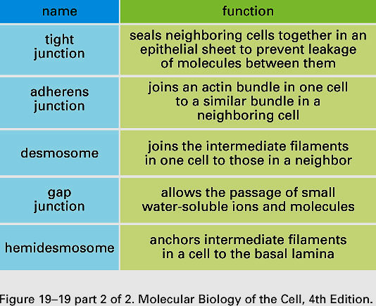

Slide 11
Extracellular matrix (ECM)
1- A network of proteins, glycosoaminoglycans (GAGs) and combinations of the two (proteoglycan) found in the extracellular space.
2- All ECM components are secreted by cells.
3- Most cells can secrete elements of the ECM but many ECMs are built by fibroblasts.
Examples of specialized ECM:
-connective tissue, basal lamina, cartilage, bone, plant/fungi cell walls, myelin sheath.

Slide 12
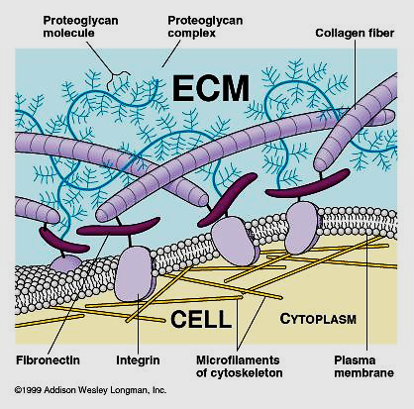

Slide 13
Components of the extracellular matrix:
Proteins/glycoproteins (secreted by co-translational import) differ in physical properties (e.g. size, flexibility) and are able to bind to different combinations of macromolecules on cell membranes (e.g. integrins, cadherins) and other ECM elements.

Slide 14
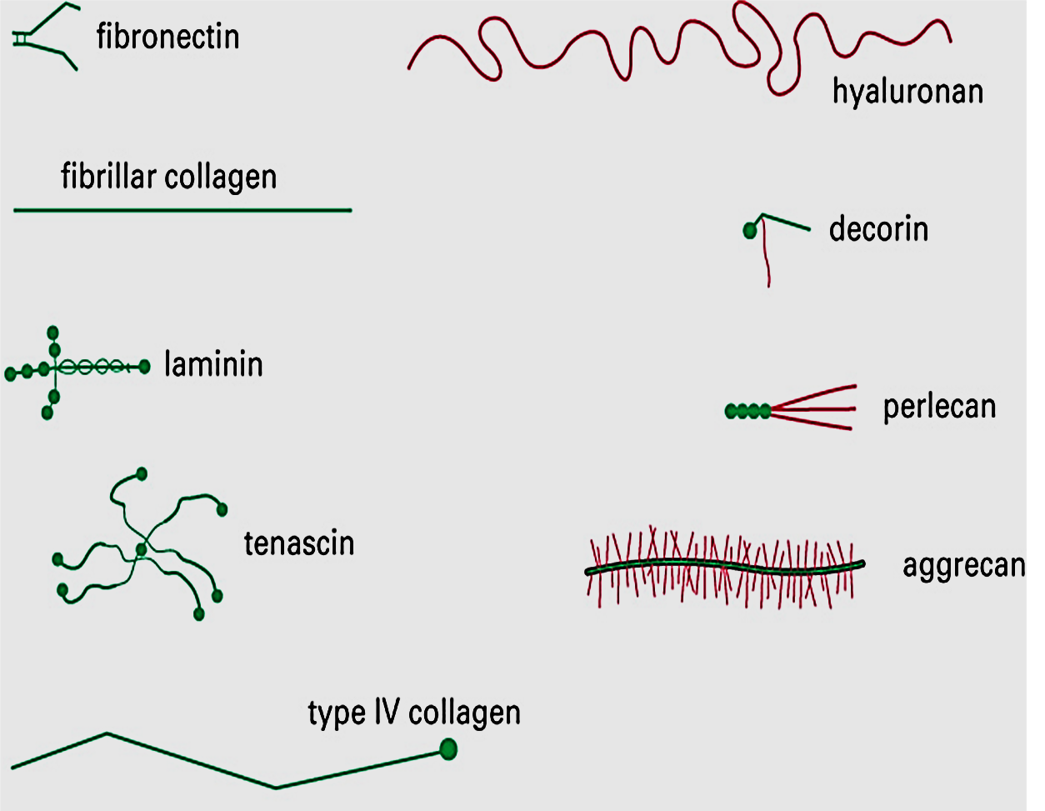
Examples of ECM include:
-collagen, elastin, fibronectin, laminin

Slide 15
Control of ECM
Cells control the synthesis of ECM by altering gene expression and co-translational import and secretion.
They also control the degradation of the ECM by secreting and activating/inactivating extracellular enzymes.
Most important are a group of serine proteases called matrix metalloproteinases.

